Slide 1
What is Real & Nutritious Food: What about Food Additives?
Lisa Y. Lefferts, MSPH
Senior Scientist
Center for Science in the Public Interest

Slide 2
What is Real & Nutritious Food?
Nutrition
Food Safety
Additives

Slide 3
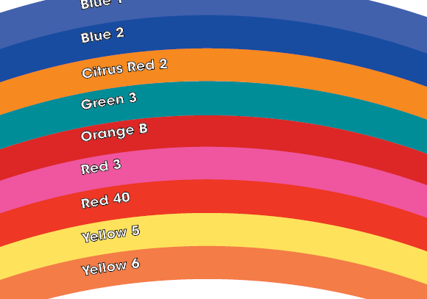
Food Dyes
Cosmetic, Not Nutritional/Health Function
Mask Absence of/Displace Colorful Fruits & Vegetables
Behavioral, cancer, allergy concerns

Slide 4
Where are the Cherries & Berries in Tropicana Twister Cherry Berry Blast?
Ingredients: Filtered Water, High Fructose Corn Syrup, Apple and Grape Juice Concentrates, Citric Acid, Natural and Artificial Flavors, Ascorbic Acid (Vitamin C) and Red 40.
Contains 10% Juice.
Answer: on the label
(not in the bottle)

Slide 5
Rainbow Grab-n-Go Salads from Kalispell Public Schools in Montana

Slide 6
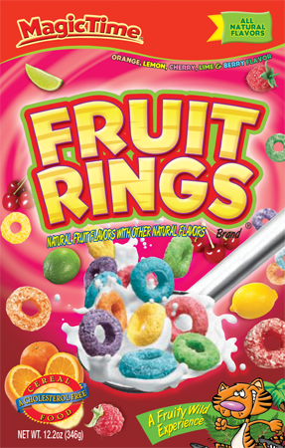
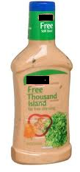
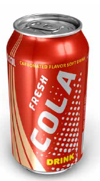
Artificial Coloring
Red 40, Blue 1, Blue 2, Yellow 6,
Turmeric, Annatto
Red 40, Yellow 6, Blue 1
Caramel Coloring

Slide 7
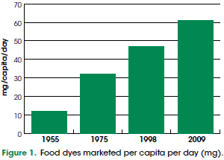
Increased Usage of Dyes

Slide 8
Risks of Food Colors: Behavior
“for certain susceptible children with ADHD and other problem behaviors, the data suggest that their condition may be exacerbated by exposure to a number of substances in food, including, but not limited to, artificial food colors.”
FDA, 2010

Slide 9
Risks of Food Colors: Behavior
“Exposure to food and food components, including artificial food colors and preservatives, may be associated with adverse behaviors, not necessarily related to hyperactivity, in certain susceptible children with ADHD and other problem behaviors, and possibly in susceptible children from the general population.”
-- FDA, 2010

Slide 10
Risks of Food Colors: Behavior
“If a child shows signs of hyperactivity or Attention Deficit Hyperactivity Disorder (ADHD), eliminating the colours* considered in the Southampton study from their diet might have some beneficial effects on their behavior.” - UK Food Standards Agency
* Includes Yellow 5, Yellow 6, Red 40

Slide 11
Risks of Food Colors: Behavior
The label “may have an adverse effect on activity and attention in children” is required in Europe on foods containing any of the “Southampton” colors (includes Yellow 5, Yellow 6, and Red 40).

Slide 12
Other Risks of Food Colors
Cancer – Red 3, Yellow 5, Yellow 6, Red 40, Caramel
Red 3 – carcinogenic, banned from cosmetics, externally applied drugs, and lakes
Yellow 5, Yellow 6 – benzidine, 4-amino-biphenyl (US ROC: “known to be a human carcinogen”)
Red 40 – p-cresidine (US ROC: “reasonably anticipated to be a human carcinogen”)
Caramel (ammoniated) – 4-methyl-imidazole (IARC: “possibly carcinogenic to humans”
Allergic reactions – Blue 1, Red 40, Yellow 5, Yellow 6; annatto, cochineal

Slide 13
Food Colorings – Solutions
Ban dyes that cause cancer and adverse behavioral impacts
Require warning notices for dyes that impact behavior, as the EU has done
Require front label disclosure of any added coloring
Press companies not to use artificial colorings

Slide 14
Caffeine
The only drug that is present naturally or added to widely consumed foods
Should a mildly addictive stimulant drug be permitted at school?
(photo credit: Mararie/flickr)

Slide 15
Caffeine
FDA states “Caffeine is a central nervous system stimulant,” and “Some studies show that caffeine causes a physical dependence or addiction.” http://www.fda.gov/downloads/drugs/resourcesforyou/consumers/buyingusingmedicinesafely/understandingover-the-countermedicines/ucm205286.pdf

Slide 16
American Academy of Pediatrics on Caffeine
“Rigorous review and analysis of the literature reveal that caffeine and other stimulant substances contained in energy drinks have no place in the diet of children and adolescents.”
-- Pediatrics 2011;127:1182–1189

Slide 17
Caffeine: Institute of Medicine Nutrition Standards for Foods in Schools (2007)
“…the committee did not support offering products containing significant amounts of caffeine for school-age children because of the potential for adverse effects, including physical dependency and withdrawal …. Thus the committee judged that caffeine in significant quantities has no place in foods and beverages offered in schools.”

Slide 18
Caffeine at School
Several states do not allow caffeinated beverages in schools, including:
California Connecticut
Hawaii Massachusetts
New Mexico Rhode Island
Vermont localities in Utah, etc.
Many caffeine-free low calorie beverages are available on the market.

Slide 19
Caffeine: Breaking Boundaries
Traditional sources: Coffee, tea, soda, cocoa
Medicines: headache remedies, cough/cold medications, weight-reduction products
New foods: chips, popcorn, waffles, ice cream, syrup, oatmeal, granola, candy, trail mix
New beverages: bottled water, energy drinks
Other New Products: sprays, lotions, lip balm, patches, shampoos

Slide 20
FDA Investigation of Caffeinated Products
“Our concern is about caffeine appearing in a range of new products, including ones that may be attractive and readily available to children and adolescents, without careful consideration of their cumulative impact.”
“The proliferation of these products in the marketplace is very disturbing to us.
-- FDA Deputy Commissioner Michael R. Taylor, May 2013

Slide 21
Caffeine and ER Visits
ER visits due to energy drinks have increased over 13-fold between 2005 and 2011, with 1,499 visits reported in children aged 12 to 17 in 2011.
-- US Substance Abuse and Mental Health Services Administration, The Dawn Report (2013)

Slide 22
Caffeine in Coffee: Breaking Boundaries
FDA (2007): 100 mg/5 ounce cup
Starbucks: 330 mg/16 ounce cup (415 mg/20-ounce cup)

Slide 23
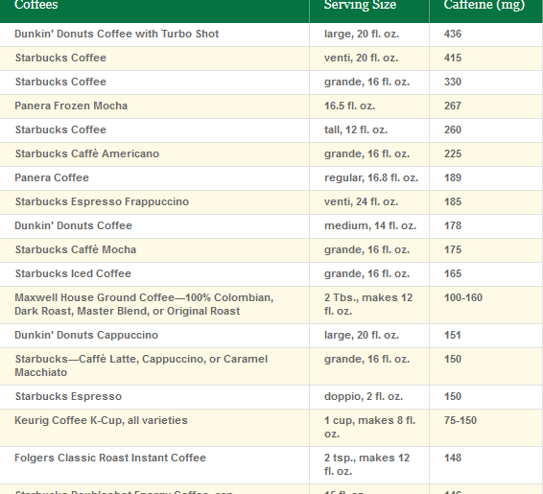
Caffeine Levels
Caffeine Intoxication (DSM-5): can occur “with low doses (e.g., 200 mg) in vulnerable individuals such as children, the elderly, or individuals who have not been exposed to caffeine previously.”
Canadian recommended limit for children under 12: 2.5 mg/kg (e.g., 85 mg for children 10-12)
FDA official limit for cola and pepper soft drinks: 71 mg per 12-ounce serving (200 ppm)

Slide 24
Caffeine - Solutions
Caffeine, a mildly addictive stimulant, is not appropriate for consumption by children and adolescents (AAP)
Caffeinated products should not be sold in schools, including high schools (IOM)
Caffeine content should be required to be listed on the label
FDA should act to limit the proliferation of caffeine-added products in the marketplace.

Slide 25
Other Food Additives of Concern
“Reasonably Anticipated to be a Human Carcinogen”:
BHA (a preservative)
Methyleugenol and acetaldehyde (flavoring agents)

Slide 26
Other Food Additives of Concern
“Clear evidence of carcinogenic activity”:
Aloe vera (ingested)
Ginkgo biloba

Slide 27
Other Food Additives of Concern
“Having concluded that FD+C Red No. 3 causes cancer in rats, the agency hereby terminates the provisional listing of FD+C Red No. 3 for use in cosmetics and externally applied drugs and the provisional listing of the lakes of FD+C Red No. 3 for use in food, drug, and cosmetic products” (21 CRF81.10)
Red 3 is still used in candy, fruit roll-ups, and baked goods

Slide 28
Other Food Additives of Concern
Aspartame:
Caused cancers at multiple sites in 3 independent animal studies
CSPI has carefully reviewed these studies and evaluations of the laboratory conducting them
These studies are more powerful and more reliable than earlier, industry-sponsored studies

Slide 29
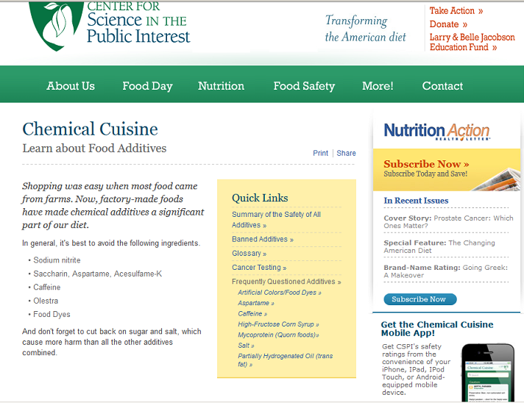
Which food additives are safe and which are not?
See http://www.cspinet.org/reports/chemcuisine.htm

