Slide 1
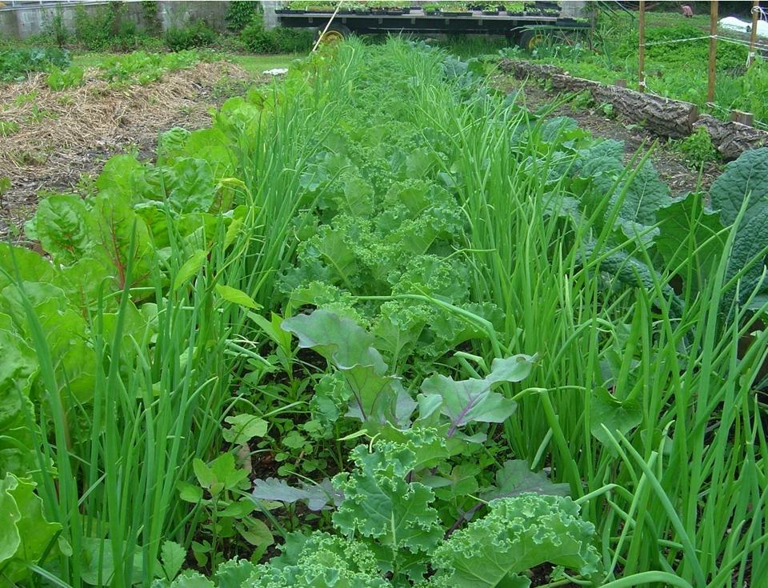
Division of Nutrition Services
Planting a New Beginning
Chef Anthony Geraci
November 2013

Slide 2


Visionary Leadership

Slide 3

A brand new approach…

Slide 4
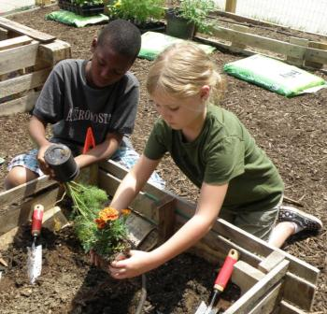
Strategic Priority 1 – Increase Participation
Proactively work to increase participation
  Develop a marketing campaign to target Memphis and Shelby County residents who are unaware of their meal eligibility
  Send multilingual flyers about the Summer Food Service Program home with all school children and to organizations hosting eligible summer programs, and include the Mayors in a media event announcing the Program

Slide 5
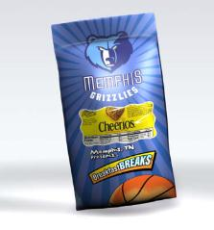


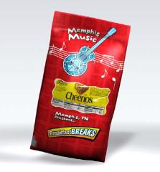
Success On The Bluff:
How We Roll In Memphis
Success In Birdland.
Revised For
The River City

Slide 6
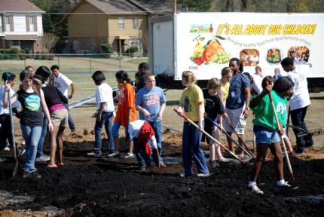
Strategic Priority 2 – NS Brand
Develop awareness of the Nutrition Services brand
  Educate Nutrition Services staff and district employees on the difference between “Nutrition Services” and the “Central Nutrition Center”
  Monitor local, regional and national news outlets
  Actively seek and promote relevant awards
  Be national in our work

Slide 7
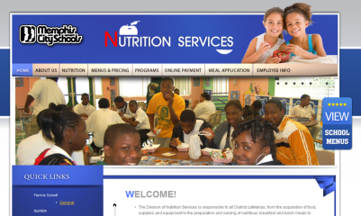
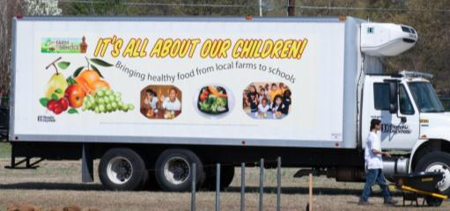
Branding Projects Underway
Web site update
Vinyl Wraps

Slide 8
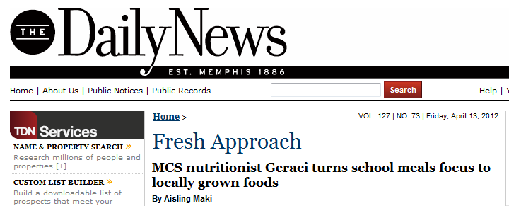

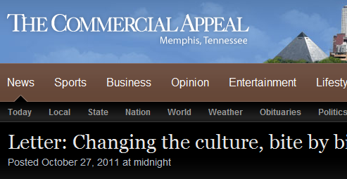

Recent Press

Slide 9
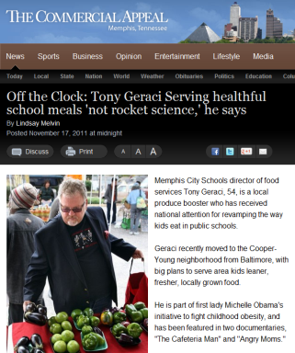
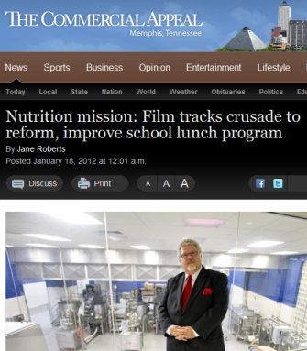
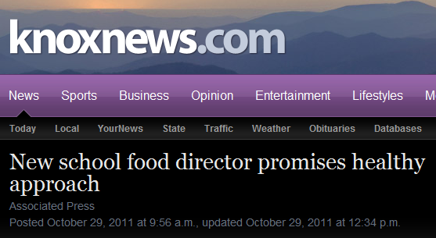
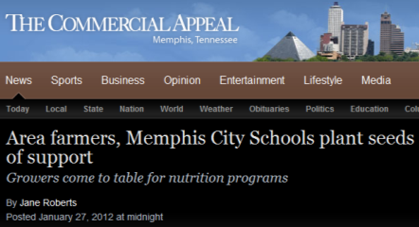
More Press

Slide 10

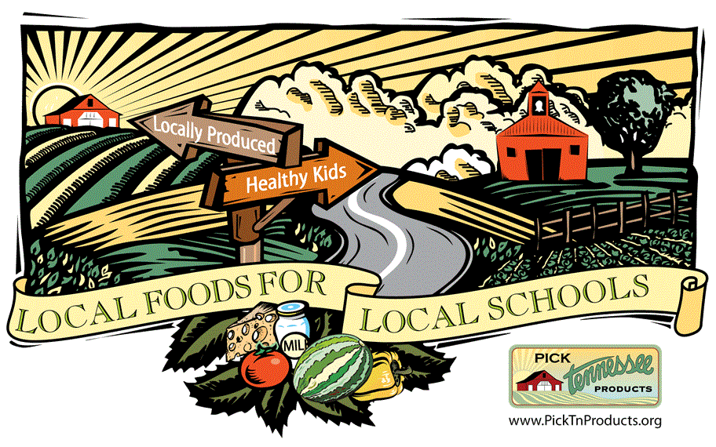
Strategic Priority 3 – Farm to School
Implement and expand Farm to School opportunities in Memphis and Shelby County
Partner with local, state, regional and national groups
  Provide leadership and support to Tennessee districts
  Enhance economic opportunities for students and local farmers
  Advance understanding of Farm to School to meet Memphis’ needs

Slide 11
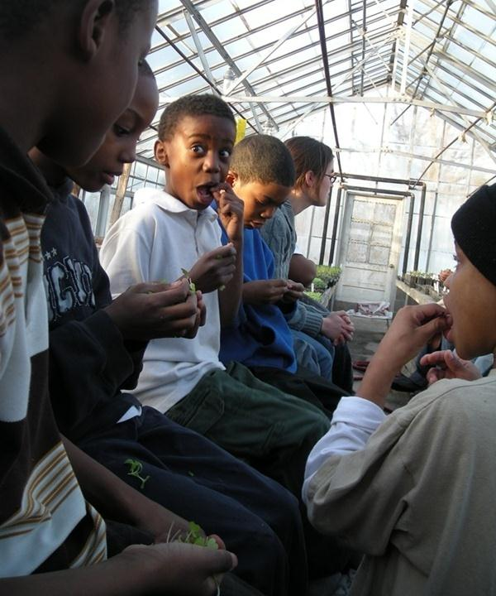
Teaching with taste

Slide 12
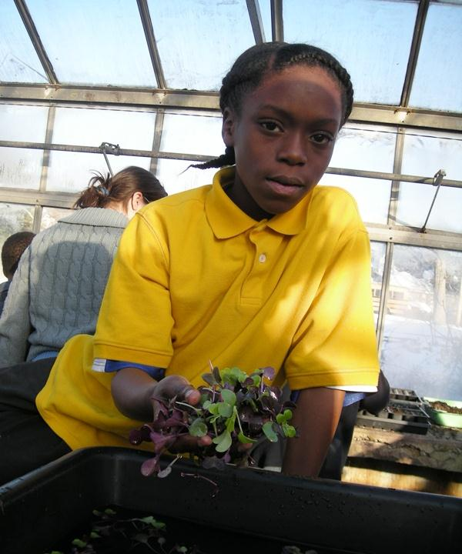
Teaching for careers, college & more

Slide 13
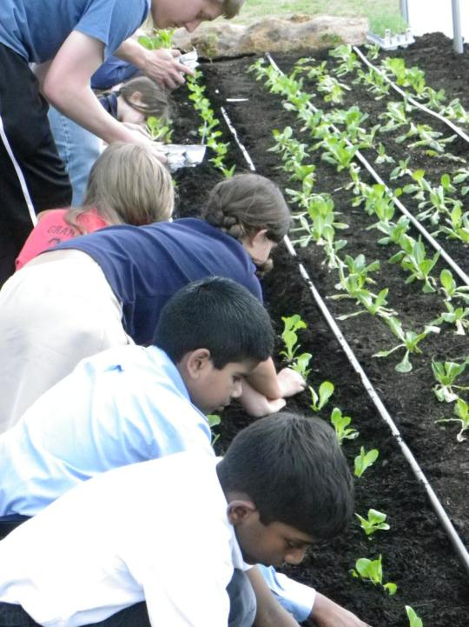
Grounding education with the earth –
Teaching Moments

Slide 14
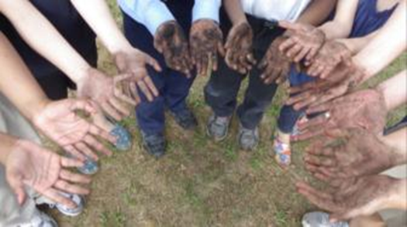
Partnering for Success

Slide 15
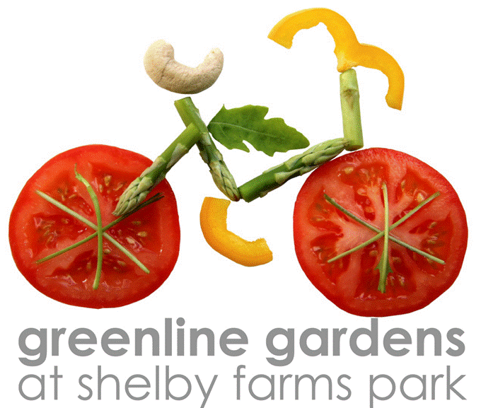




Greenline Gardens Partnership

Slide 16
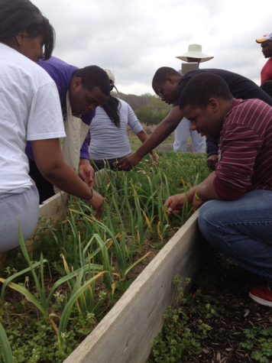
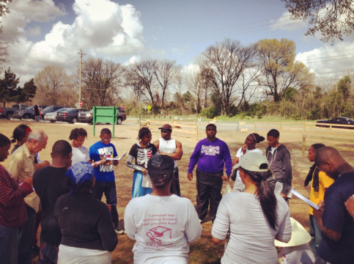
Greenline Gardens Fellows

Slide 17
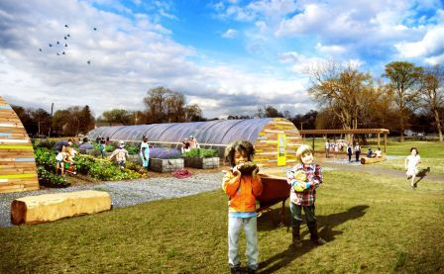







School Gardens Partnership
Existing Gardens
Balmoral-Ridgeway ES
Craigmont HS (CTE)
Cummings ES
Germanshire ES
Klondike ES
Peabody ES
Expanding Gardens
Carnes ES
Double Tree ES
Douglass HS
Keystone ES
Grahamwood ES Demonstration Garden

Slide 18
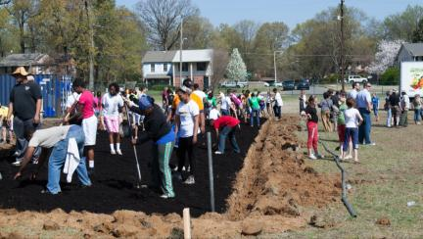
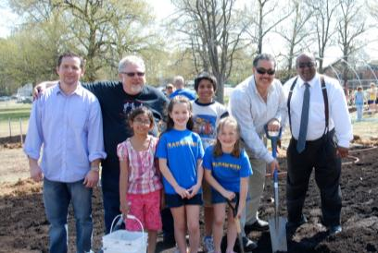

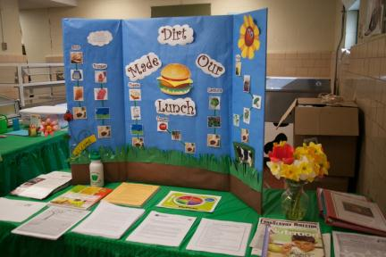
Grahamwood Garden Kickoff

Slide 19
Hoop House Build
The key advantages of using hoop houses (high tunnels) are as follows
Frost protection, 4+º F.
Above ground level for earlier soil warming, advancing the growing season.
Small heaters can be used to give additional frost protection.
Structures are easily constructed from readily available materials.
Hoop houses can be used to start trays of vegetable seedlings early season.
Can be planted with heat-loving crops that are allowed to grow to maturity.
Hoop/plastic covering can be manipulated and/or removed to control internal temperatures.
Compact size allows for season extension in backyard areas.
Vertical Integration – producing our own food for our kids by our kids.

Slide 20
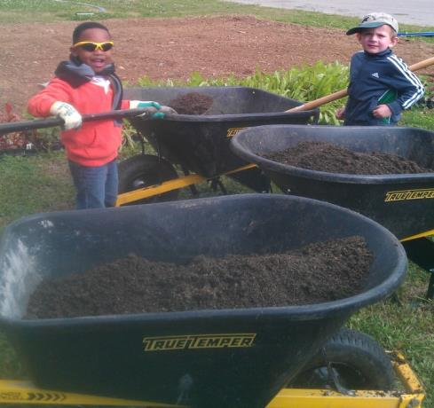
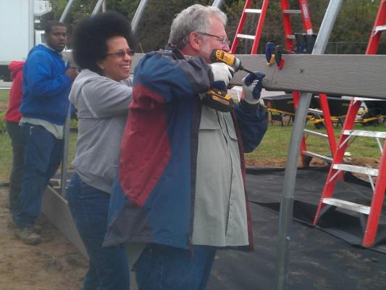
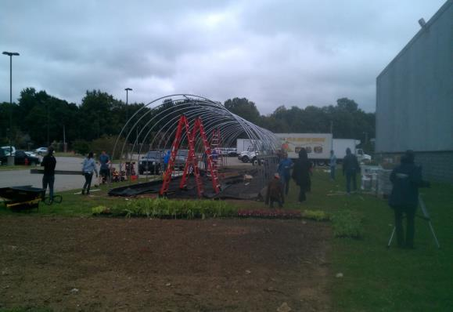
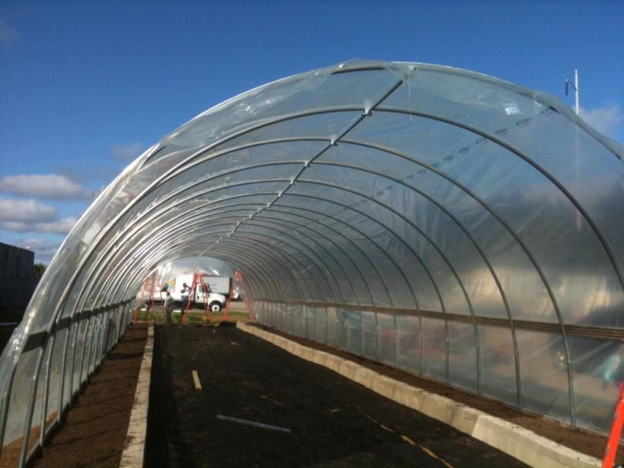
CNC Hoop House Build September 2013

Slide 21
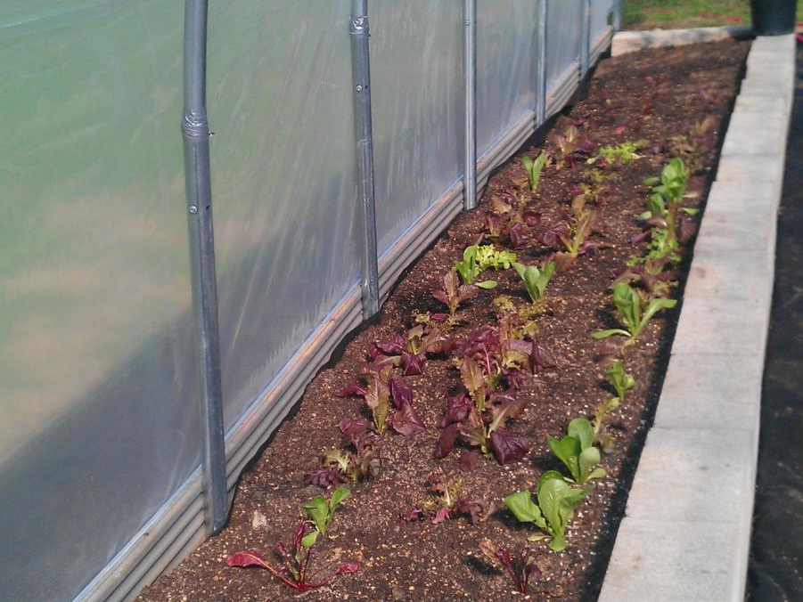
First crops from the hoop house!

Slide 22
Strategic Priority 4 – Expand Technology Use
Expand the use of the use of technology, fostering citizen-centered engagement with a greater volume of service at lower cost
  Online Free & Reduced applications
  Online tools for parents
  Automated Back of House food service management application

Slide 23
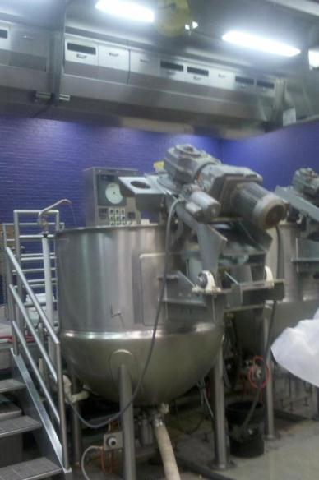
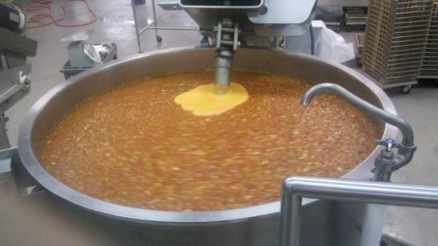
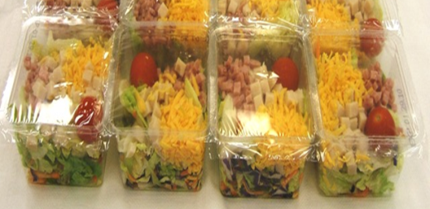
World Class Facilities

Slide 24
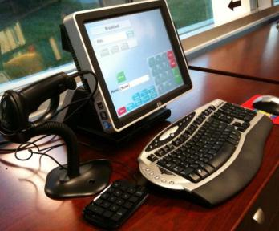
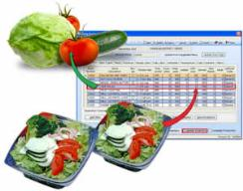
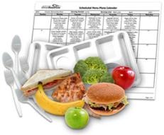
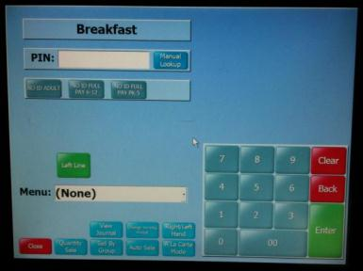


Industry Leading Technology

Slide 25
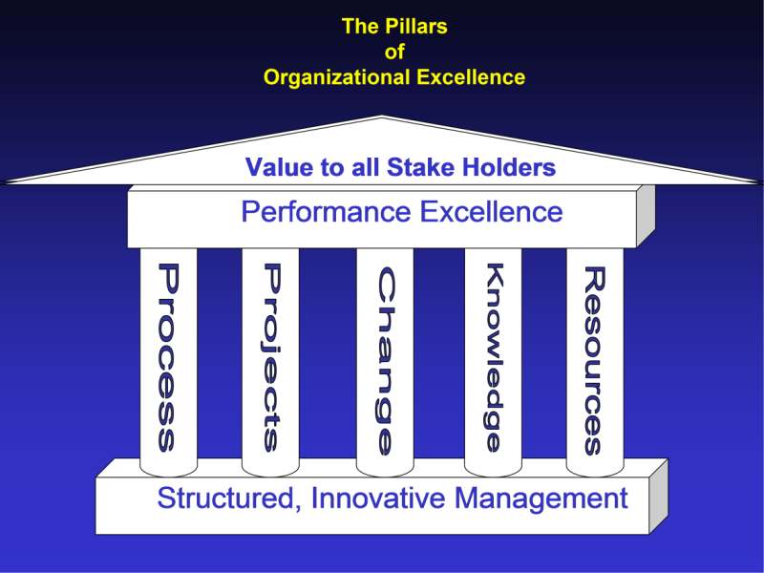
Strategic Priority 5 – Management and Organizational Excellence
Achieve organizational and management excellence
  Maximize economies of scale for the unified organization
  Become a benchmark leader in national child nutrition
Harrington Institute

Slide 26
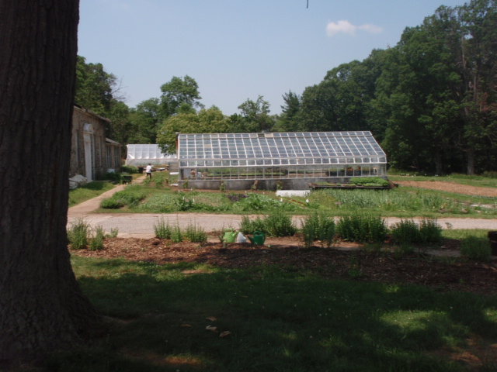
Paying the Bills

Slide 27
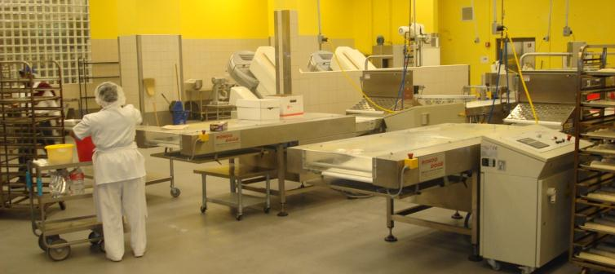
Economies of Scale
Second and third shift operations enable maximum production from fixed costs

Slide 28
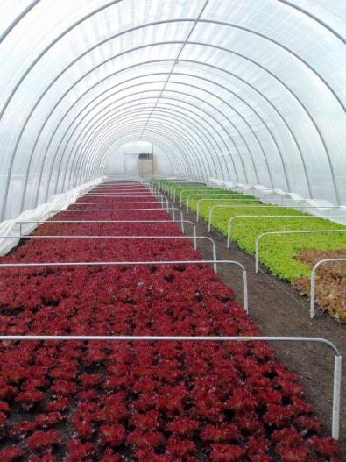
Cost-Saving Measures
Vertical integration – locally grown produce provides a high return on our investment

Slide 29

Chef Anthony Geraci
Executive Director, Nutrition Services
(901) 416 5550
Geracia@scsk12.org
www.scsk12.org

